Slide 1


Department of Computer Science and Engineering
Application Development for Mobile Petrol and Servicing
SDG 7: Affordable and Clean Energy
Team Members Name / Register Number
RAGHUL H / 211420104334
YOGAPRAKASH S / 211420104312
BARATH S / 211420104320
Guide Name & Designation
Coordinator Name & Designation
Mrs. V.Sathya preiya, M.E., Ph.D.,

Slide 2
Introduction
Convenience at your doorstep: We bring the fuel station and service center to you.
On-Demand Fueling: Refuel your vehicle wherever you are, on your schedule.
Comprehensive Servicing: Skilled technicians handle routine maintenance and repairs with ease.
Time and Cost Efficiency: Skip the queues and save time with our mobile services.
Quality Fuel: Ensure optimal performance and fuel efficiency for your vehicle.

Slide 3
Objective of the Project
Convenience: One of the primary objectives of mobile petrol and servicing is to provide convenience to customers by offering fuel delivery and vehicle servicing .
Time-saving: Mobile petrol and servicing aim to save customers time by eliminating the need to drive to a traditional petrol station or service center
Accessibility: Mobile petrol and servicing can improve accessibility to fuel and maintenance services, especially in areas where traditional petrol stations or service centers are not readily available.
Cost-effectiveness: mobile petrol and servicing providers aim to offer cost-effective solutions to customers, potentially saving them money compared to traditional alternatives.

Slide 4
Literature survey
YEAR | TITLE AND JOURNAL | AUTHOR | DESCRIPTION | ADVANTAGES | DIS ADVANTAGES
2021 | "Digital Transformation in the Automotive Service Industry: Implications of Mobile Petrol and Servicing Apps" | Lee, C. and Bagheri, B. | This journal explores the broader impact of mobile petrol and servicing applications on the automotive service industry. | Enhanced operational efficiency and reduced service costs. | Resistance to change within traditional service models.
2022 | "Enhancing User Experience in Mobile Petrol and Servicing Applications" | Smith, J. et al. | This journal explores the significance of user experience in the context of mobile applications for petrol and servicing. | Increased user satisfaction and engagement. | Development complexity associated with maintaining a high level of user-friendliness.

Slide 5
Existing System
Fleet Management Systems:
Some companies use fleet management systems that include features for monitoring and managing fuel consumption. These systems may offer real-time tracking of vehicles, fuel efficiency analysis, and fuel consumption reports.
Telematics and IoT Solutions:
Elematic systems and Internet of Things (IoT) devices are often integrated into vehicles to provide real-time data on various parameters, including fuel levels
Smart Gas Stations:
Advancements in technology have led to the development of smart gas stations that may incorporate automated fuel dispensers, digital payment systems, and real-time monitoring of fuel inventory.

Slide 6
Proposed System
Location-based Services: Implement GPS functionality to enable users to share their real-time location, facilitating accurate fuel delivery to their vehicles.
Fuel Request and Scheduling :Provide a user-friendly interface for fuel requests, allowing users to schedule deliveries based on their preferred time and location.
Secure Digital Payments: Integrate a secure payment gateway for seamless digital transactions, ensuring user convenience and financial security.
Order Tracking: Enable users to track the status of their fuel delivery in real-time, offering transparency and reassurance about the service.

Slide 7
Software / Hardware used
1)Xml 1)Processor: The lowest processor type
2) Java. 2)An Intel Core i5
3) Android studio. 3) Memory (RAM): Minimum 4 GB
4)Mobile/Computer
5)Internet Connection

Slide 8
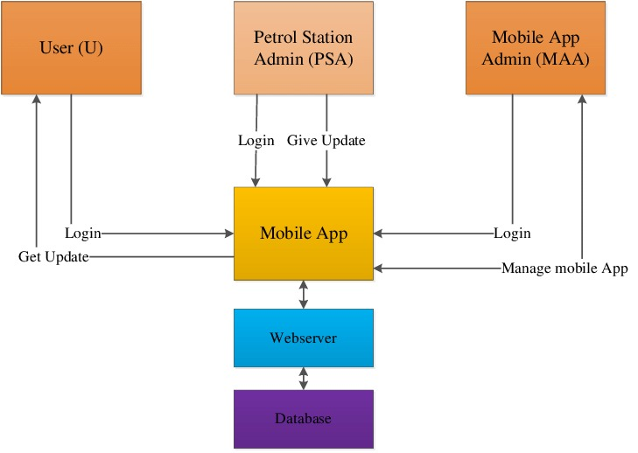
System Architecture

Slide 9
Architecture / Methodology used
The architecture of a mobile petrol and servicing operation involves the physical infrastructure, technological components, and operational processes that enable the delivery of fuel and vehicle maintenance services to customers' locations.
Fuel Delivery Infrastructure: This includes mobile fuel tankers or vehicles equipped with pumps and meters to dispense fuel safely and efficiently.
Service Vehicles and Equipment: Mobile service vehicles are equipped with tools, equipment, and supplies necessary to perform vehicle servicing and maintenance tasks.
Logistics Management System: A robust logistics management system is crucial for planning fuel delivery routes, scheduling service appointments, managing inventory, and tracking vehicles.
Payment and Billing Systems: Secure payment and billing systems are essential for processing transactions and managing customer accounts.
Communication and Customer Support: Effective communication channels, such as mobile apps, websites, or customer service hotlines, enable customers to request services, track orders, and address any inquiries or issues.

Slide 10
System Implementation
Requirement Gathering and Analysis: Define the objectives and scope of the mobile petrol and servicing system. Gather requirements through stakeholder interviews, market research, and analysis of industry trends. Document functional and non-functional requirements to guide system design and development.
System Design: Design the architecture, data model, and user interface of the mobile petrol and servicing system. Determine the technology stack and infrastructure required to support the system's functionality. Create wireframes, prototypes, and mockups to visualize the user experience and functionality.
Development: Develop the mobile petrol and servicing system according to the defined requirements and design specifications. Implement features such as fuel ordering, service scheduling, vehicle tracking, and payment processing.

Slide 11
Result & Discussion
Functionality and Service Accessibility: The mobile petrol and servicing initiative successfully introduced on-demand fuel delivery and vehicle servicing to customers' preferred locations. Customers were able to order fuel and schedule servicing appointments conveniently through the mobile app or website.
Operational Efficiency: The system streamlined fuel delivery routes and service scheduling, resulting in improved operational efficiency. Real-time tracking of service vehicles allowed for dynamic route optimization and timely service delivery.
Customer Feedback and Satisfaction: Customer feedback surveys indicated a high level of satisfaction with the convenience and reliability of the mobile petrol and servicing solution.

Slide 12
Refrences
[1] Douglas A. McCausland, Donald P. Mook, US Patent 7422684B2 ,"Development of a mobile laboratory for real-time analysis of alternative fuels", https://ieeexplore.ieee.org/document/4391100
[2] Daniel J. C. Herr, Denny K. S. Ng, Journal of the Air & Waste Management Association, "A Mobile Pilot Plant for the Production of Synthetic Natural Gas from Biomass" https://ieeexplore.ieee.org/document/4391111
[3]Christian Wallmann, Volker Lenz, Michael Harasek, Energy & Fuels, "Mobile Energy: Insights into the economic value of mobileenergy" https://ieeexplore.ieee.org/document/4391103
[4]Philip Warburg, Morgan Bazilian, ScienceDirect, "Development of a Mobile Fuel Cell System for Commercial Vehicles" https://ieeexplore.ieee.org/document/4391106

Slide 13

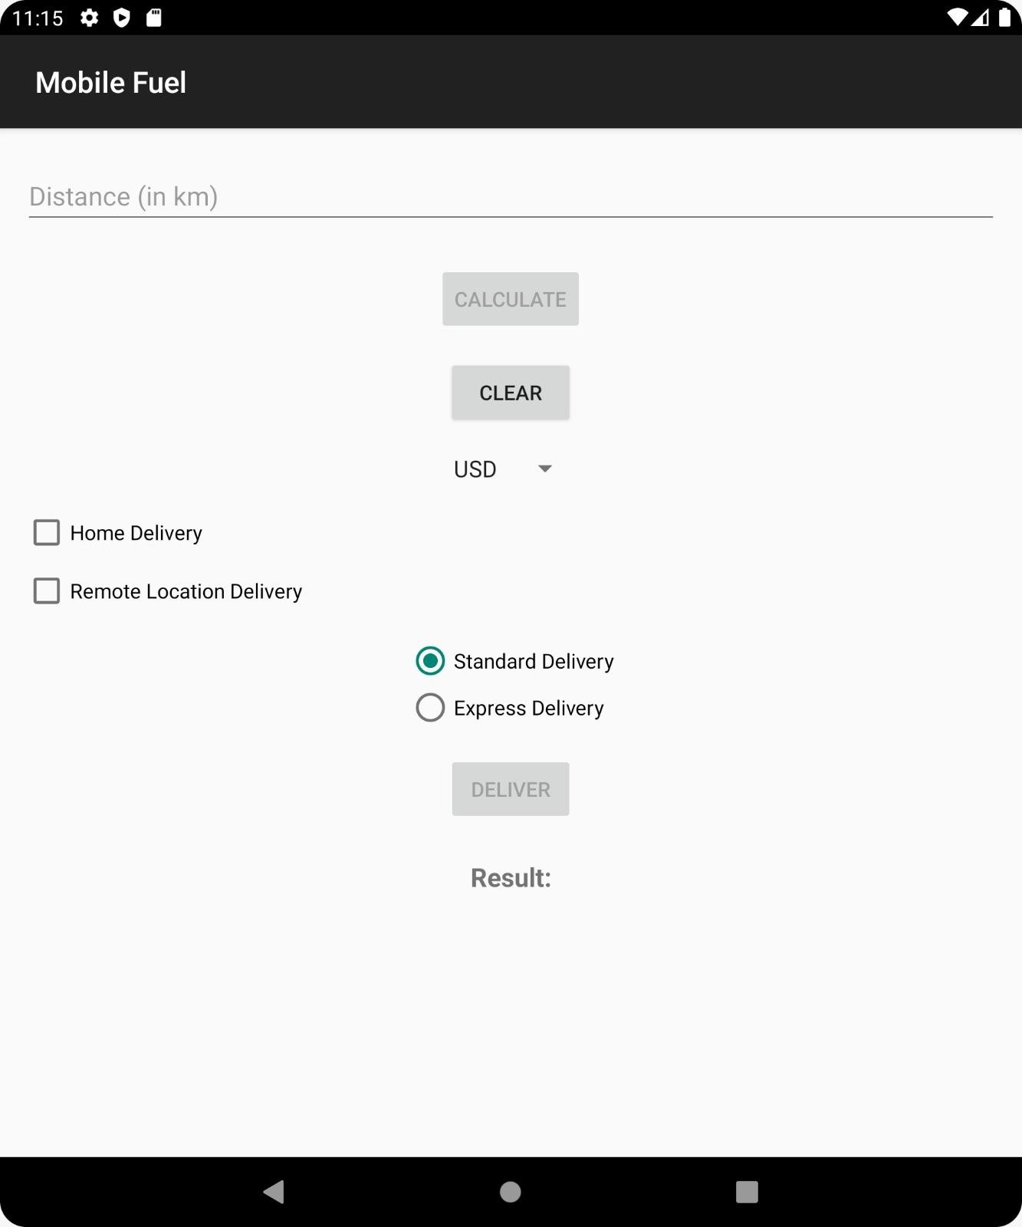
Screenshots

